Slide 1
Storyboard for project two

Slide 2
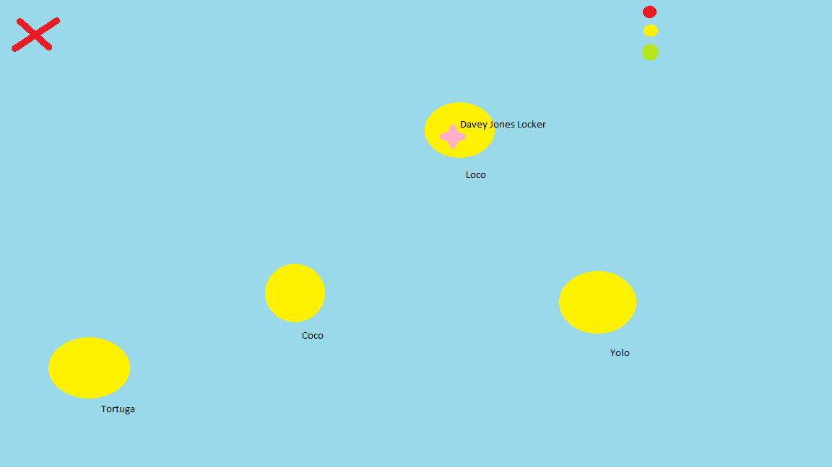

Slide 9
Explanation
The robot will start from the ‘X’
Then it will make its way to different islands
It will only move if the lights are on green
If the lights turn red then it will pause and not move
Once it has reached the island it will dig for treasure
Once it is done it will move to another island repeated the process until all the treasure has been collected.

Slide 10

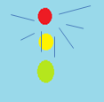
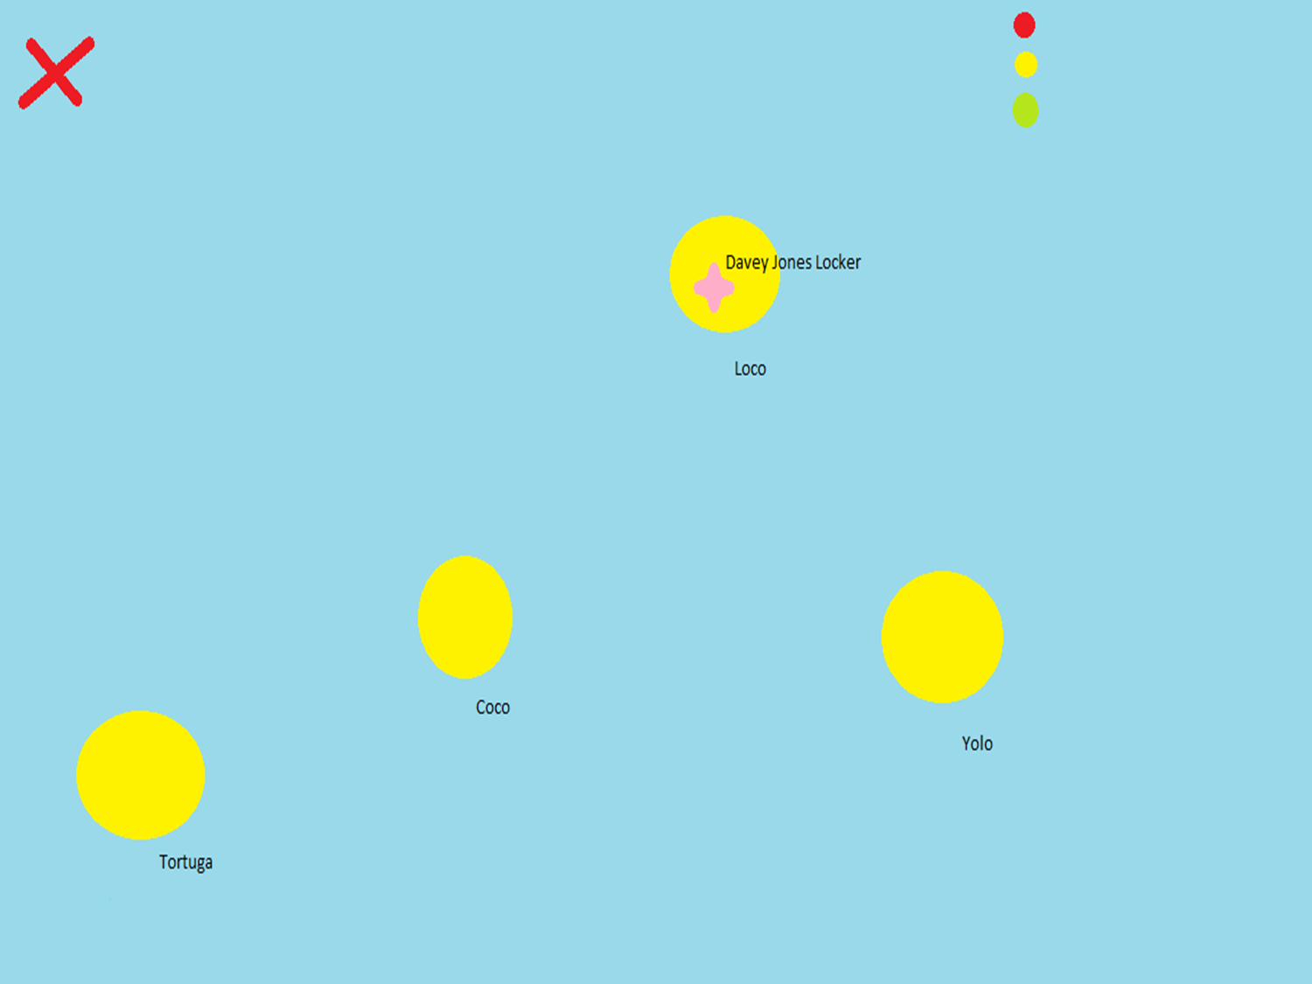
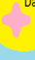
Key
Robot
Traffic lights
Landmark
Starting Point Of Robot
Treasure

